Slide 1
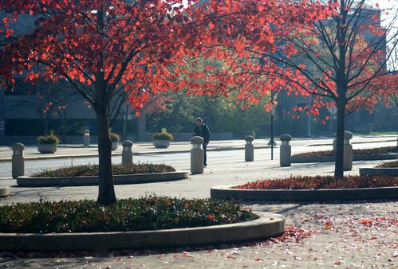
Faculty Recruitment and Retention

Slide 2
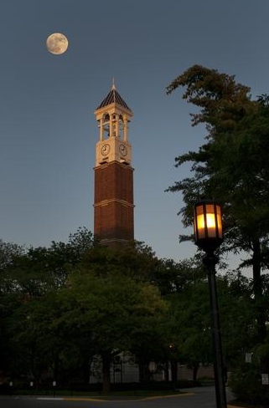
Background
Provost Office Initiative
Office of Faculty Recruitment and Retention/College of Engineering – Concierge
How we arrived here

Slide 3
Partners Move Purdue Forward

Slide 4
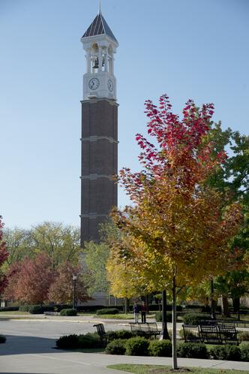
Accomplishments
114 Clients
61% Recruitment
39% Retention
49 Offers
34 Internal
15 External
43 Placements

Slide 5
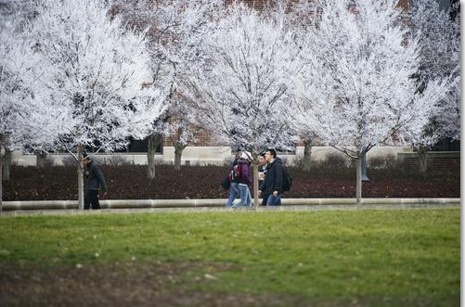
What’s Next
Guidelines
Consortium with other Indiana Universities
Surveys
Dual Career Brown Bag Series
Advisory Board
Annual Celebration

Slide 6
Feedback
Since first impressions last a life time, what was your first impression of Purdue?
Have you or your partner used the services of the Office of Faculty Recruitment and Retention or the Engineering Concierge Program? How would you describe the service you received?
What types of other services would you like for us to offer?
What was your experience with realtors?
Would you and your partner enjoy attending various social functions? At the University? In the community? If so, what would interest you?
What other feedback would you like to offer?

Slide 7
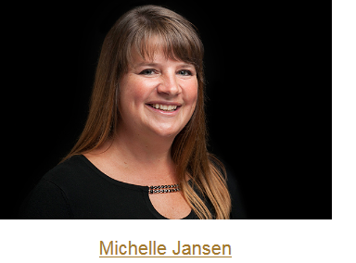
Thank you

